Slide 1
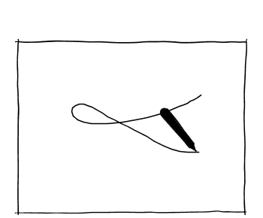


Free-Hand Sketching
Trauma & PTSD
Research Question
Methodology
Screening PTSD
Implication
Future Work
Free-Hand Sketching
Pencil
Paper
Notes:
Free-hand sketching is one of those skills that occur to us almost naturally. Using a simple pencil and paper we can sketch easily.

Slide 2
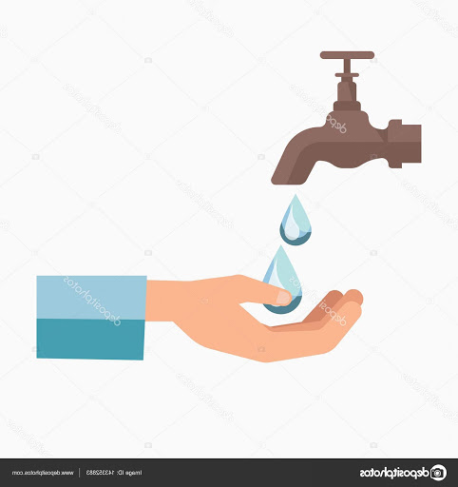



Free-Hand Sketching
Trauma & PTSD
Research Question
Methodology
Screening PTSD
Implication
Future Work
Post-Traumatic Stress Disorder (PTSD)
Resource constraints
Difficulties in traumatic self-disclosure
Social stigma around mental health issues
Diagnosis of PTSD
Notes:
Now, there are also tasks For example, diagnosis of mental health disorders such as PTSD that are difficult to access/ administer due to various social constraints. PTSD manifests as an aftermath of traumatic exposure.

Slide 3




Free-Hand Sketching
Trauma & PTSD
Research Question
Methodology
Screening PTSD
Implication
Future Work
WHO World
Mental Health Survey
24 Countries
~68k people
70% participants experience
Lifetime traumas
Reference: Kessler et al., 2017
Low income communities
High income communities
Traumatic Exposure
Reference: Atwoli et al., 2015
Notes:
The WHO world mental health survey reveals that traumatic experiences are pervasive among the societies worldwide. However, the exposure is higher within low-resource communities where access to initial diagnosis is most often difficult.

Slide 4
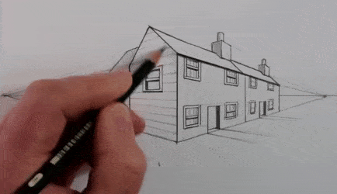



Free-Hand Sketching
Trauma & PTSD
Research Question
Methodology
Screening PTSD
Implication
Future Work
Can we utilize quantitative methods to identify patterns from free-hand sketches and use them to screen for PTSD?
Novel
Low-cost
Creative
Free-hand sketching
Screening PTSD
Notes:
To this end, we utilize people’s natural ability of sketching to design a novel , low-cost, and creative method for screening PTSD. In particular we ask this research question:

Slide 5








Leveraging Free-Hand Sketches for Potential Screening of PTSD
Farhana Shahid, Wasifur Rahman, M. Saifur Rahman, Sharmin Akther Purabi, Ayesha Seddiqa, Moin Mostakim, Farhan Feroz, Tanjir Rashid Soron, Fahmida Hossain, Nabila Khan, Anika Binte Islam, Nipi Paul, Ehsan Hoque, and A. B. M. Alim Al Islam.
UNIVERSITY of ROCHESTER
Notes:
Our work is titled “Leveraging Free-Hand Sketches for Potential Screening of PTSD”., where, we have collaborated with a diverse group of researchers across different disciplines. And I am Farhana Shahid from BUET who is presenting this work to you.

Slide 6





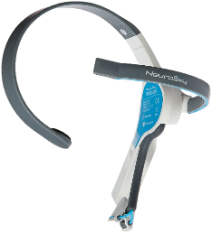


Free-Hand Sketching
Trauma & PTSD
Research Question
Methodology
Screening PTSD
Implication
Future Work
44 Rohingya refugees
35 Slum-dwellers
85 Engineering students
PTSD screening tool
Ground truth
EEG headset Low-cost: $99
Portable
Pencil
Paper
Free-hand sketches of home
Participants’ end
Mobile phone
camera
EEG data while sketching
Digital images
Researchers’ end
Notes:
In this regard, we collected data from three diverse groups: Rohingya refugees, slum-dwellers, and engineering students.
We interviewed the participants using a PTSD screening tool that sets the ground truth of our study.
For the drawing task, we used only pencil & paper considering their simplicity, low-cost, ease of use and availability.
We selected home as our drawing subject considering its appeal and familiarity among our participants irrespective of their diverse background.
On the researchers’ end, we used a regular, low-cost mobile phone camera to digitize the sketches.
Besides, to gain a deeper understanding of the drawing task we collected EEG data while sketching from the refugees.

Slide 7
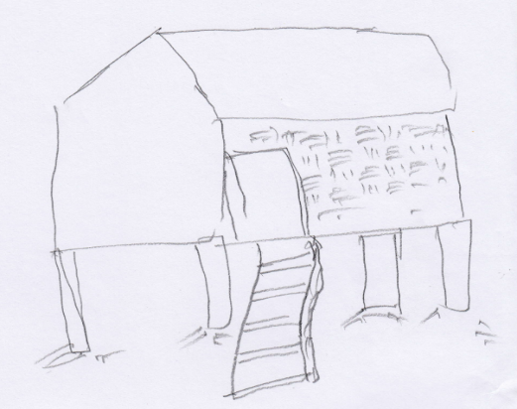
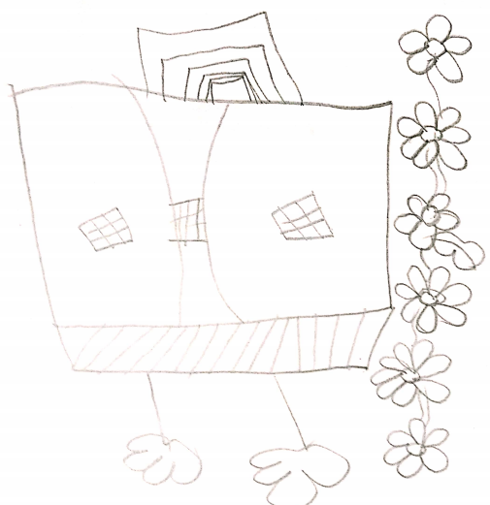
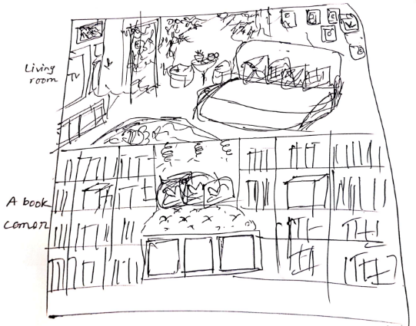
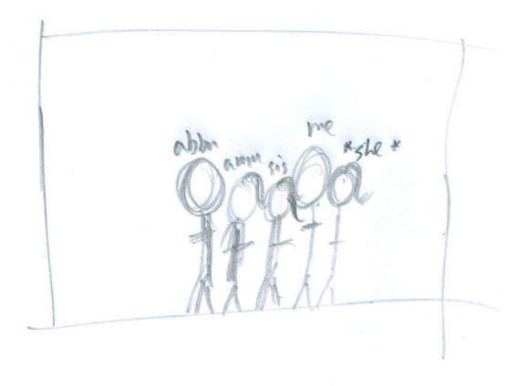
Free-Hand Sketching
Trauma & PTSD
Research Question
Methodology
Screening PTSD
Implication
Future Work
Qualitative Sketch Themes
Shelter
Nature
Activities
Relationships
6

Slide 8
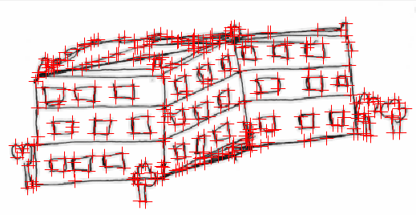
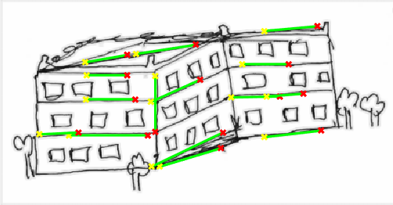
Free-Hand Sketching
Trauma & PTSD
Research Question
Methodology
Screening PTSD
Implication
Future Work
Quantitative Sketch Features
Number of corners
332 corners
Number of strokes
Average length of strokes
19 strokes, average length: 57
Notes:
Besides, we extracted three features from the sketches using image processing algorithms. These are, # of corners, # and average length of strokes.

Slide 9


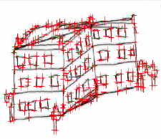
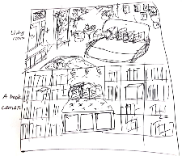
Free-Hand Sketching
Trauma & PTSD
Research Question
Methodology
Screening PTSD
Implication
Future Work
Logistic Regression Models for Screening PTSD
Four Models
Gender
Group
Sketch features
Sketch themes
Interaction effect
Gender
Sketch features
Group
Sketch features
Accuracy: 87.9%,F1-score: 0.876
Combining data from all participants

Slide 10
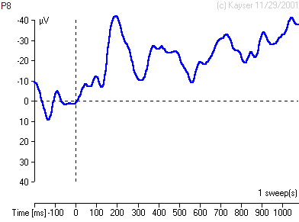
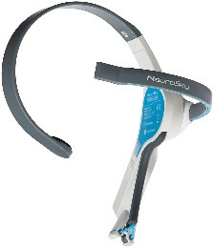
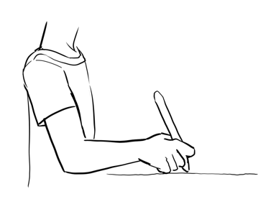
Free-Hand Sketching
Trauma & PTSD
Research Question
Methodology
Screening PTSD
Implication
Future Work
Random Forest Model for Screening PTSD
EEG data
Sketch features
Accuracy: 99.3%, F1-score: 0.993
Using data from Rohingya refugees
9

Slide 11
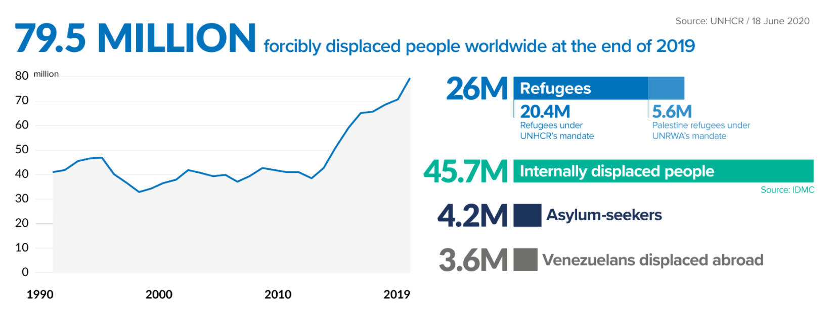
Free-Hand Sketching
Trauma & PTSD
Research Question
Methodology
Screening PTSD
Implication
Future Work
Pencil
Paper
Mobile phone camera
Resource-stricken populations
10

Slide 12





Free-Hand Sketching
Trauma & PTSD
Research Question
Methodology
Screening PTSD
Implication
Future Work
Non-verbal art form
Communication barrier
Difficulties in traumatic self-disclosure
Image processing
algorithm
Machine learning
algorithm
Standardized, repeatable, objective
11

Slide 13


Free-Hand Sketching
Trauma & PTSD
Research Question
Methodology
Screening PTSD
Implication
Future Work
Our Work
Low-cost
Non-verbal
assessment
Low-resource
communities
Future Work
Collect data from large diverse populations
12

Slide 14
Thank You
13

